Slide 1
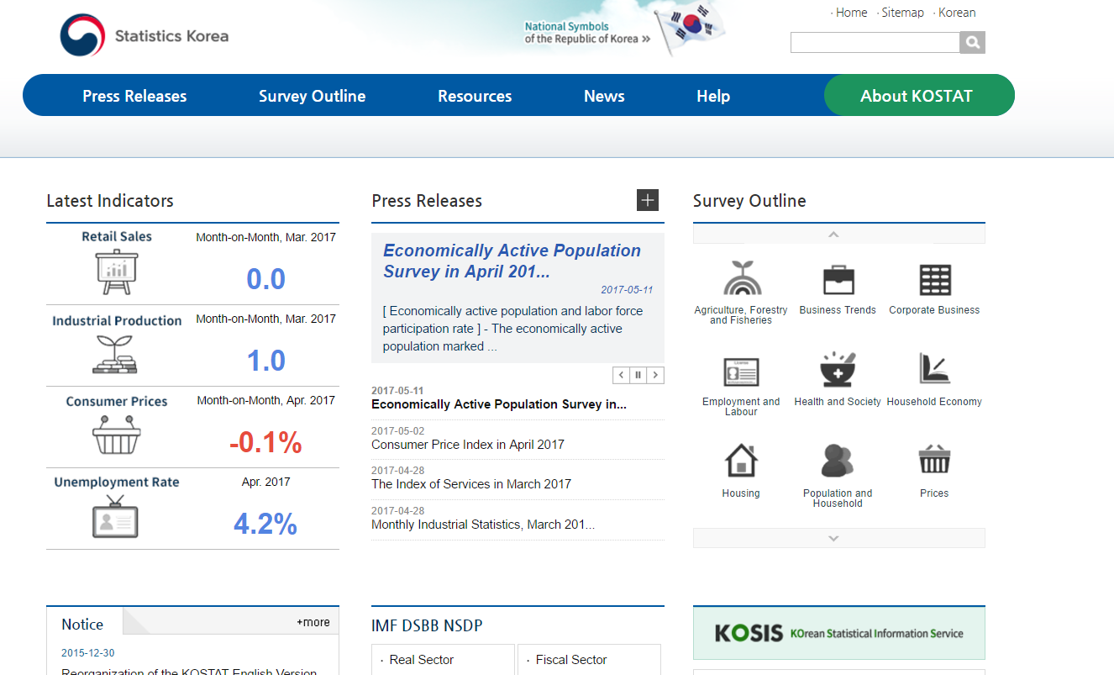
Procedure to obtain PPI data for Korea
Go to:
Click on “KOSIS” (Korea Statistical Information Service)
kostat.go.kr/portal/english

Slide 2
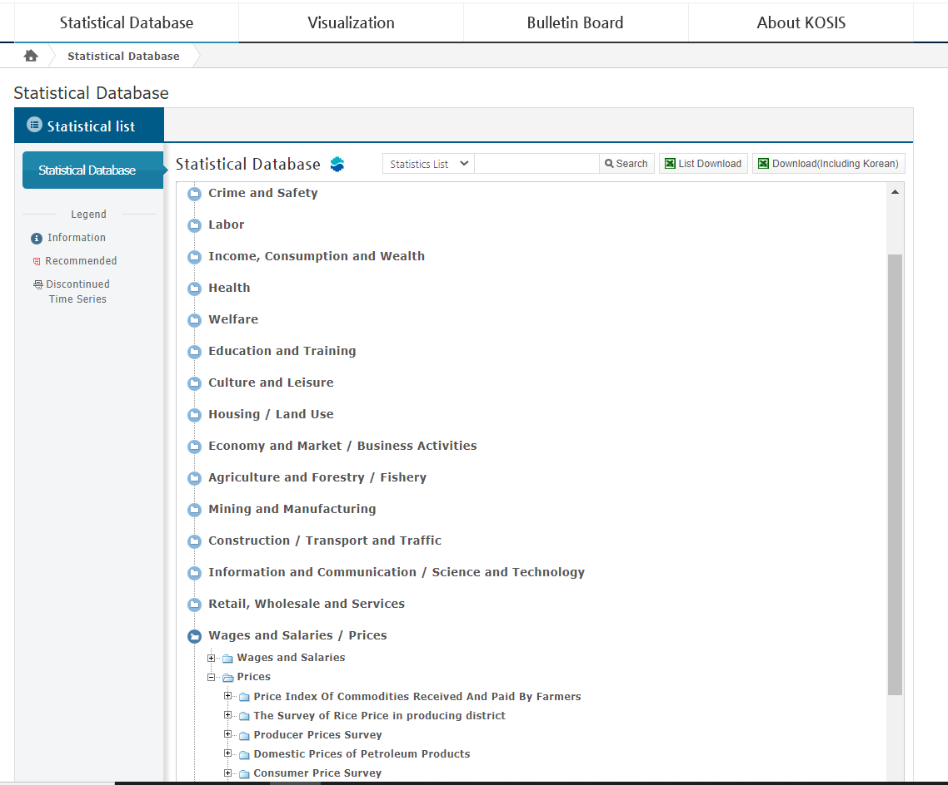
Procedure to obtain PPI data for Korea
Click on “Statistical Database”
Click on “Wages and Salaries / Prices”
Click on “Prices”
Then click on “Producer Prices Survey”

Slide 3
Procedure to obtain PPI data for Korea
Then click on “Producer Price Indexes (Basic Groups)”
Note: If your product is not found here, it may be found in “Producer Price Indexes (Special Groups)”

Slide 4
Procedure to obtain PPI data for Korea
Select “Setting Criteria” from the new opened tab
From the new opened window select the required items and the required time period.
Ex: Crude Steel for the year of 2015, Monthly data.
Next Click “Apply”
…

Slide 5
Procedure to obtain PPI data for Korea
The Price Index is displayed in the top table
Data can be downloaded by clicking the download icon to the right
Choose the file type required and then click on Download
…

